Slide 1
Mapp project:
Auto adjusting and multi-purpose Solar power garden
Group members: Qixuan, Poorva Sandhiya, Benson Lee, Ryan

Slide 2
TABLE OF CONTENTS
Insights gained
Sustainability
Persona
Brainstorming
2 x 2 matrix (Impact/Feasibility)
Concept sketch
Flow charts
Block diagram
Circuit diagram
Implementation plan(timeline)
Possible limitations
Future implementations

Slide 3
01
Insights Gained
Light Poverty

Slide 4
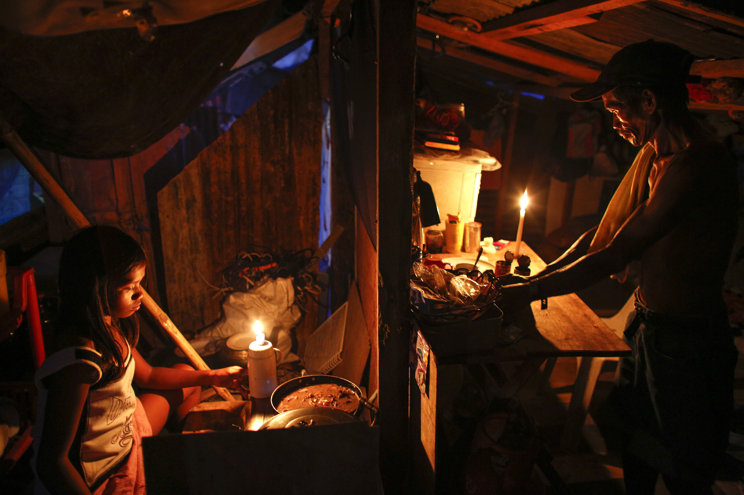
Light poverty is caused by an imbalance in the availability of modern technology in certain areas.
More than 1.3 billion live in light poverty
They also have inferior living conditions and fewer opportunities due to their lack of access to adequate lighting.
https://www.labmate-online.com/news/news-and-views/5/breaking-news/what-is-light-poverty/37414
https://www.who.int/news/item/04-04-2022-billions-of-people-still-breathe-unhealthy-air-new-who-data#:~:text=Almost%20the%20entire%20global%20population,limits%2C%20and%20threatens%20their%20health.
https://www.nultylighting.co.uk/blog/lighting-for-good-light-poverty/#:~:text=One%20of%20the%20most%20startling,of%20access%20to%20adequate%20lighting.

Slide 5
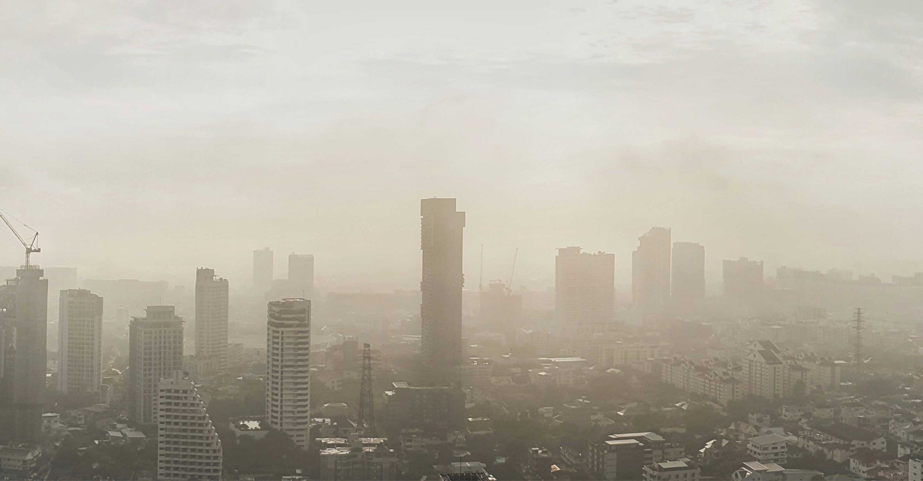
They have resort to inefficient, primitive lighting sources, such as candles and kerosene lamps, which are not only expensive but also a danger to life.
Almost the entire global population (99%) breathes air that exceeds WHO air quality limits, and threatens their health
There are about 1.1 million people without access to artificial light

Slide 6
02
Sustainability

Slide 7

Area of Interest
Our team wanted to create a multi-purpose mini solar panel powered farm that can also benefit the less fortunate areas of the world. We chose to work on 7. Affordable and clean energy, 13. Climate action and 11. Sustainable and communities.

Slide 8
Major problems that we are trying to tackle
Light poverty. Many areas in the world still do not have access to readily available electricity.
Our mini solar farm also aims to reduce air pollution.
Tackling climate change with our solar powered farm.

Slide 9
Values of Project Aligned with UN SGD?
Is it affordable and accessible
Environmental Impact
UN SDGs 7,11, 13
CLIMATE ACTION
AFFORDABLE AND CLEAN ENERGY
SUSTAINABLE AND COMMUNITIES
Project is made using affordable parts and materials
Parts used to construct project is readily available and accessible
It can help individuals to reduce their energy consumption and thereby the amount of CO2

Slide 10
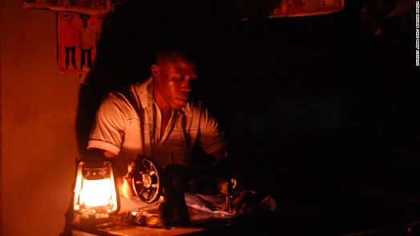
3. USER PERSONA
Name : Joe
Age: 28
Needs: Availability of Light at his convenience.
Background: He lives at a place where ready electricity is not available for his convenience. Thus he has to resort to using Kerosene lamps as a source of light. He knows that it is harmful to both the environment and the human body but he does not have any other choice.

Slide 11
04
Brainstorming

Slide 12
IDEAS
Automatic controller for street lights
Auto adjusting and multi-purpose Solar power garden
Street lights system using Solar panels
Automatic Room lighting system
Smart Air purifier pollution sensor

Slide 13
05
Feasibility VS Impact
2x2 Matrix

Slide 14
Impact
Shortlisted
Automatic controller for street lights
Auto adjusting and multi-purpose Solar power garden
Street lights system using Solar panels
Automatic Room lighting system
Smart Air purifier pollution sensor
C
B
E
D
A
Feasibility

Slide 15
Chosen Idea
Auto adjusting & multi-purpose Solar power garden

Slide 16
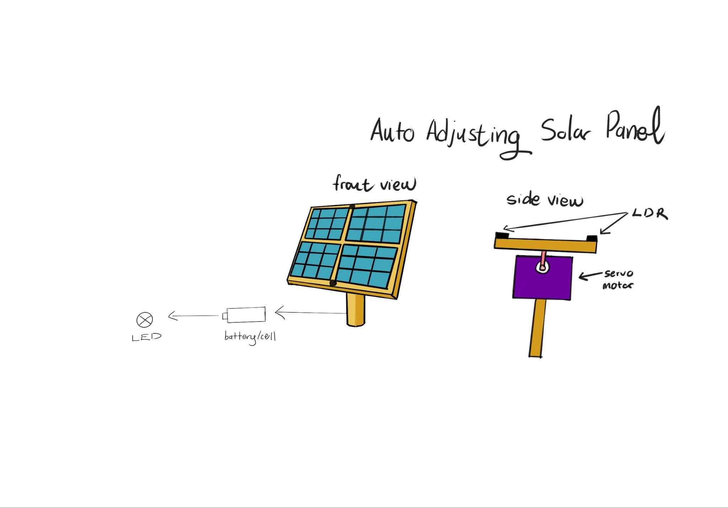
6. Concept Sketch

Slide 17
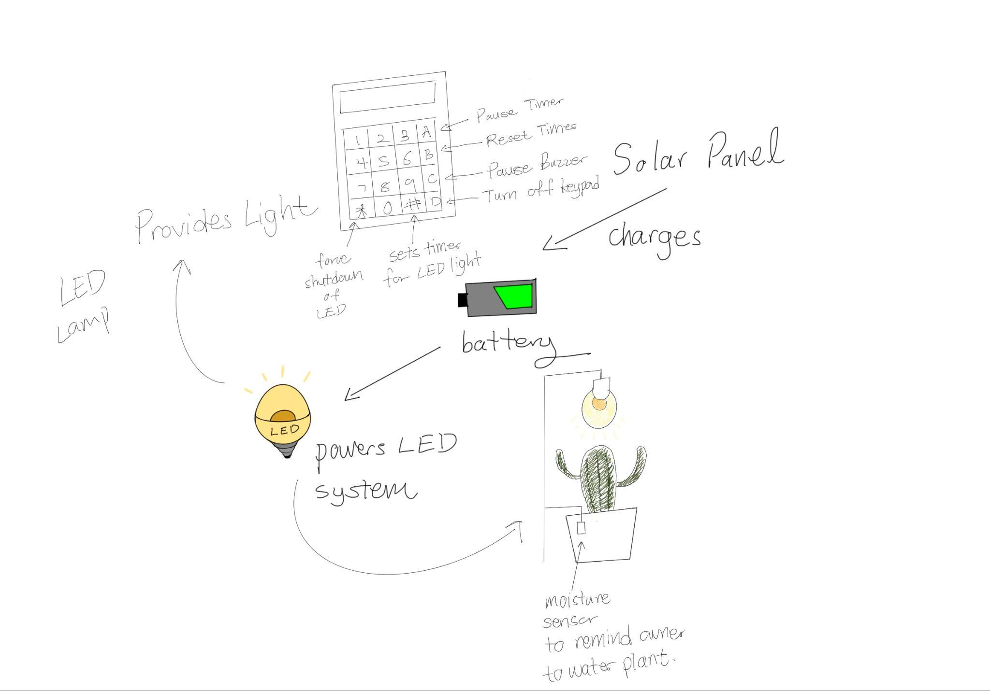
Concept Sketch

Slide 18
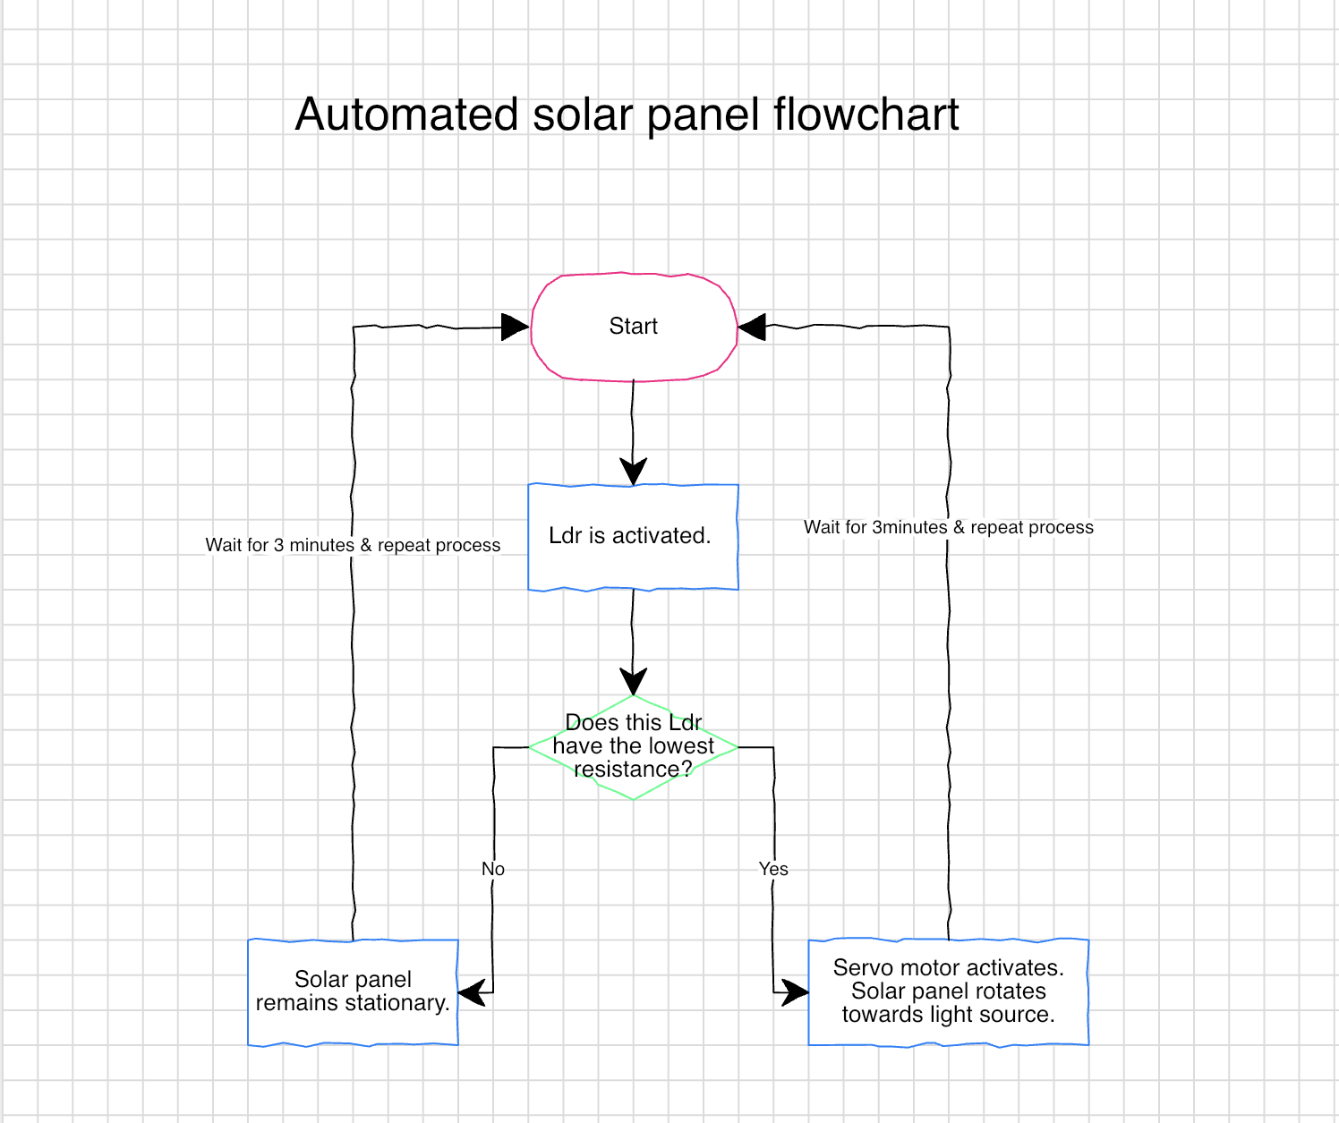
7. Flow chart for auto tuning solar panel

Slide 19
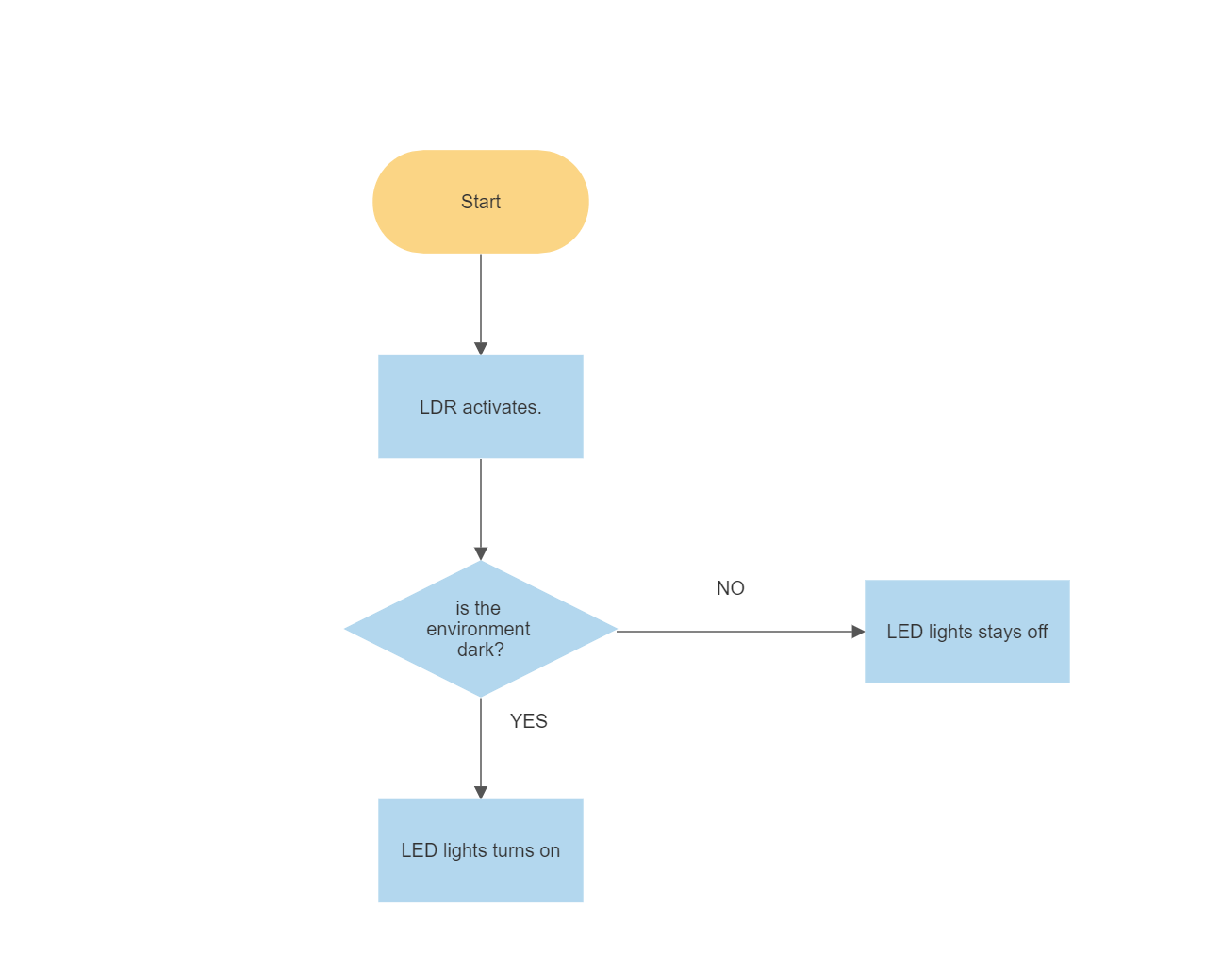
7. Flowchart for the garden/general environment

Slide 20
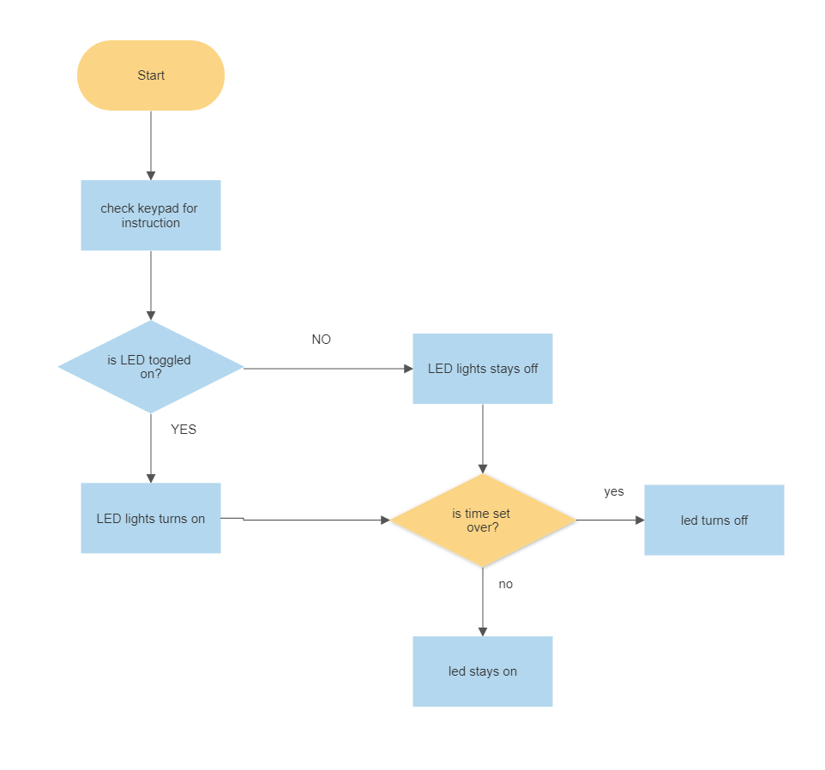
7. Flowchart for led light timer system

Slide 21
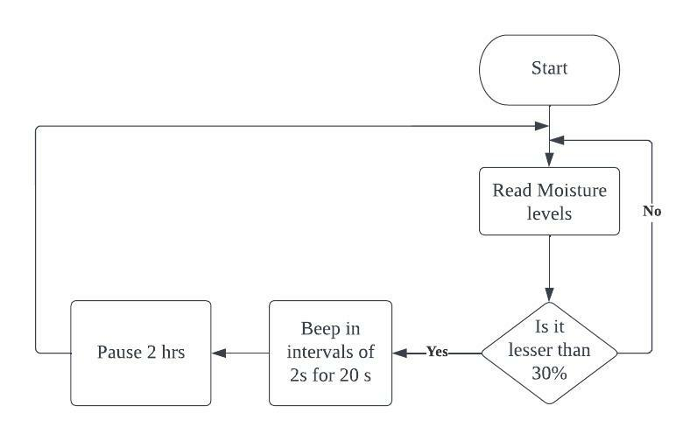
Flowchart for moisture sensor

Slide 22
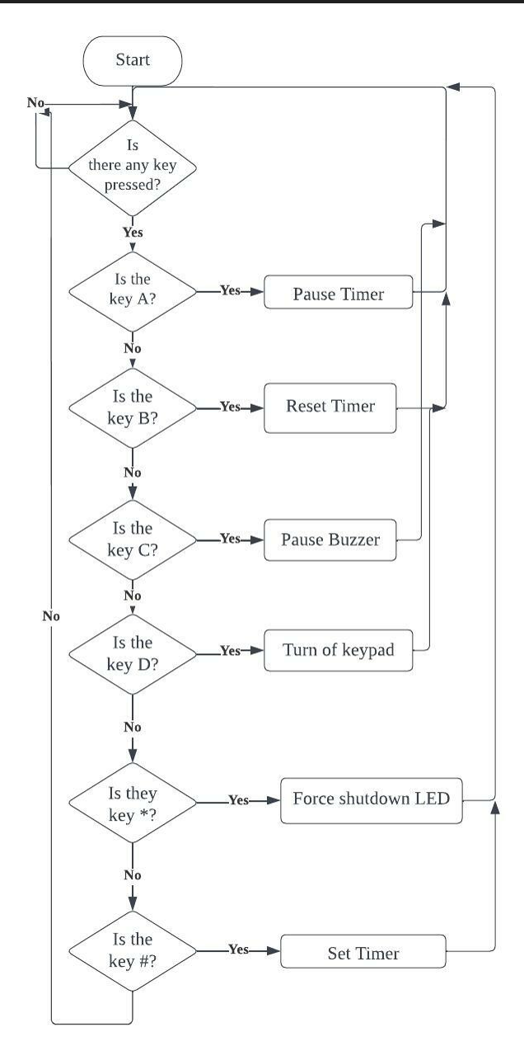
Flowchart for
keypad

Slide 23
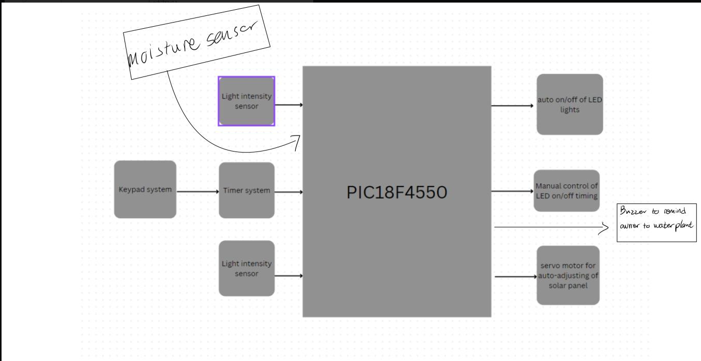
8. Block diagram

Slide 24
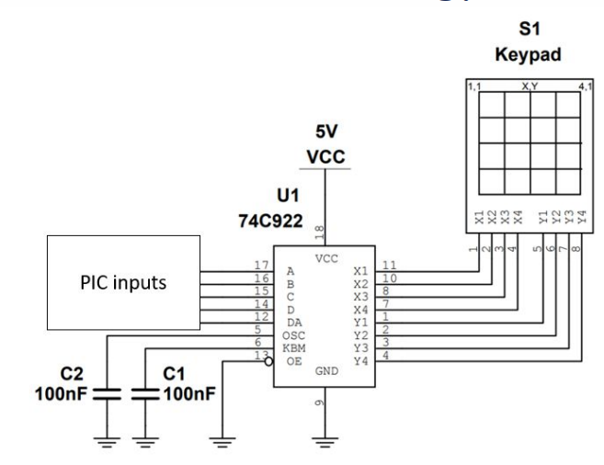
Circuit diagram for keypad

Slide 25
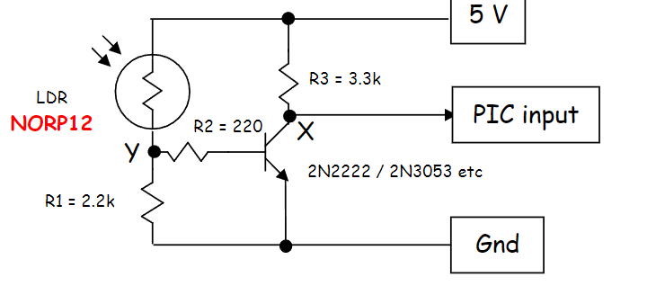
Circuit diagram for LDR
If(PortAbits.RA0 = 1){
//turn on LED
}

Slide 26
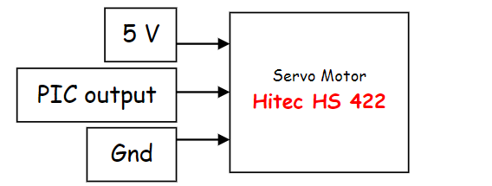
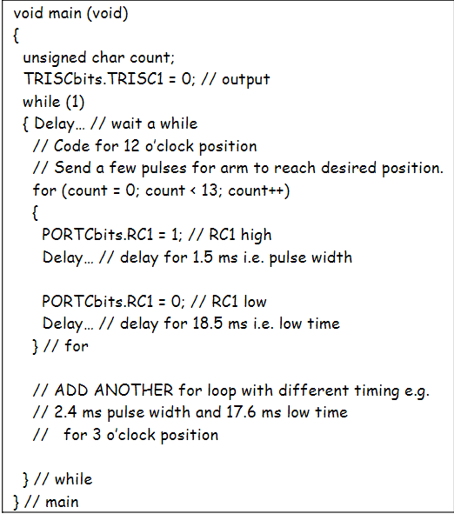
9. Circuit diagram for servo motor
Servo motors are
Controlled by
Delays.
A period of
20ms is used.

Slide 27
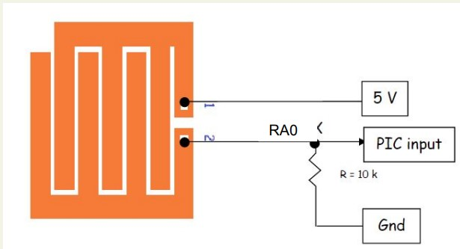
Circuit diagram for moisture sensor
if (PortAbits.RA0 = 1){
//turn on buzzer
}
PIC reads logic low when its dry, logic high when its wet.

Slide 28
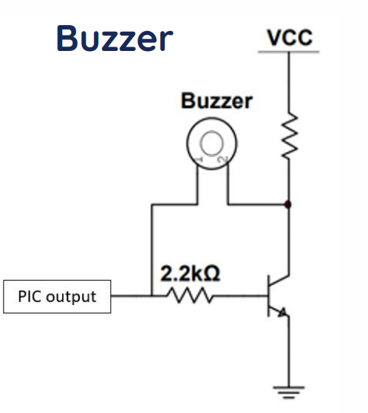
Circuit diagram for buzzer

Slide 29
Logic for Auto-adjusting solar panel
Set RA5 to analog input and use an if else statement to compare the resistance of the 2 ldrs.
Otherwise we can use arduino to control the servo motor for the auto adjusting solar panels.

Slide 30
10. Implementation Plan
Week 11 | Material Acquisition
Week 12 | Testing of sensors & evaluation of idea
Week 13 | Coding/Assembly
Week 14 | Coding/Assembly
Week 15 | Assembly
Week 16 | Assembly
Week 17 | Troubleshooting / Submission
Week 18 | Troubleshooting / Submission

Slide 31
11. Possible limitations
Our project prototype is small and might not be able to provide enough light for the communities that requires our project.
Possible solution: we can implement larger leds & more leds to provide more light.
If our system were to fail, fixing the components and troubleshooting would be difficult as these communities do not readily have access to internet. Mailing services and shops that sell replacements would also be difficult to find.
Possible solution: we can train locals to be able to troubleshoot our devices and make components more accessible
The power generated by our solar panel might not be enough for these communities.
Possible solution: we can implement larger solar panels & larger batteries to acquire more power

Slide 32
12. Future implementations
We can make extra modules to help improve quality of life. Some examples include: heater modules for colder climate regions, fan module to cool people etc;
We can increase the scale of the solar panel system and implement it in solar power farms. Large scale solar power farms will benefit from this more than smaller solar power farms.

Slide 33
THANK YOU!

